Slide 1
4 Oct, 2024 Stargate Game

Slide 2
Art Updates
Moodboards, Models

Slide 3
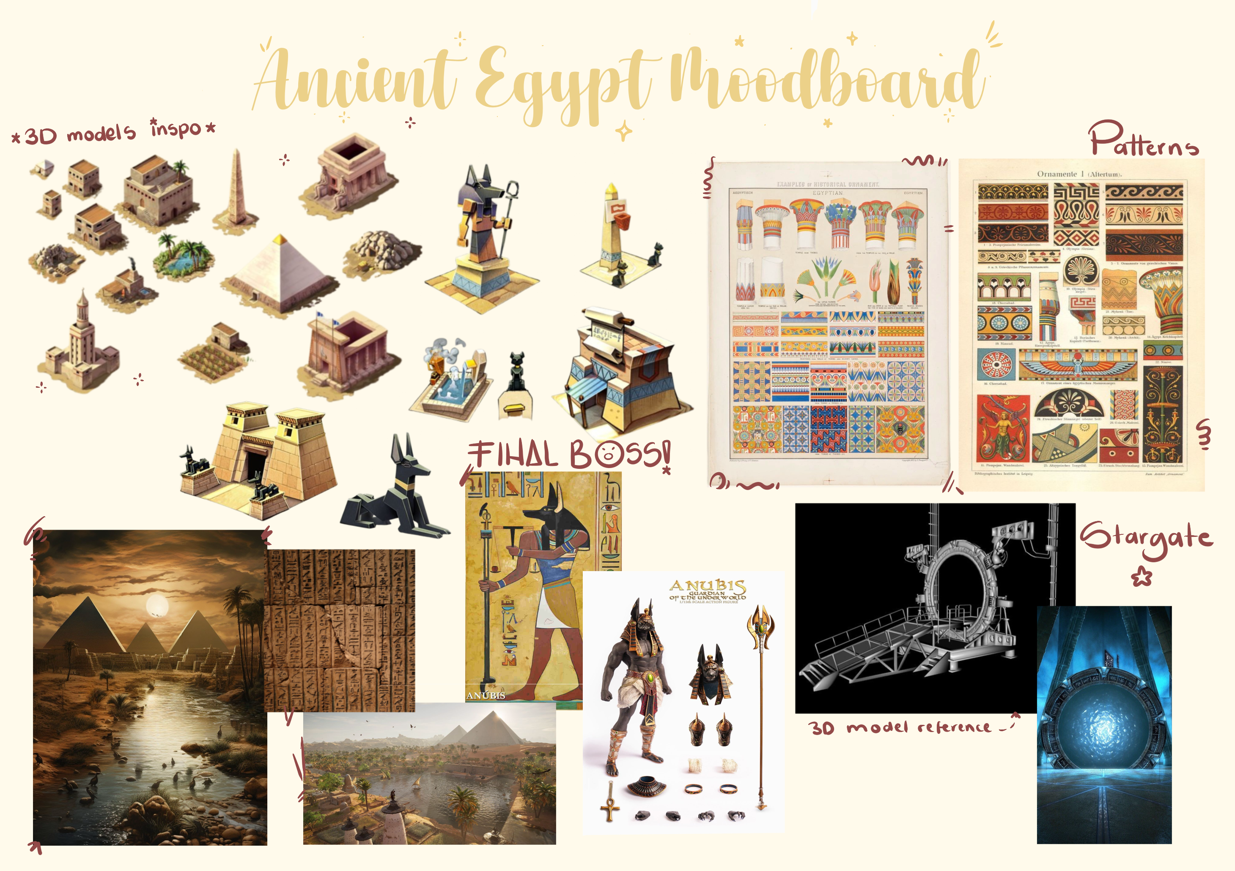

Slide 4
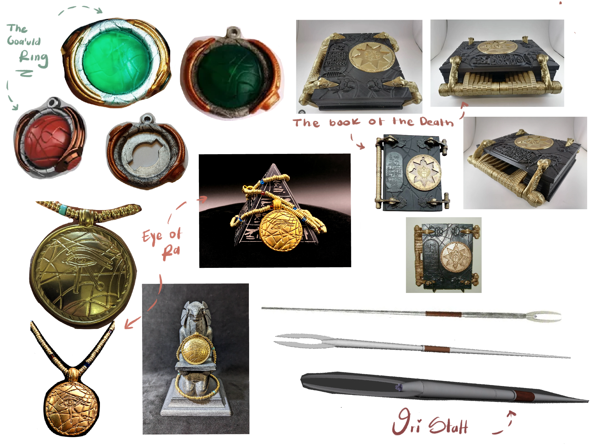
Artifacts Moodboard

Slide 5
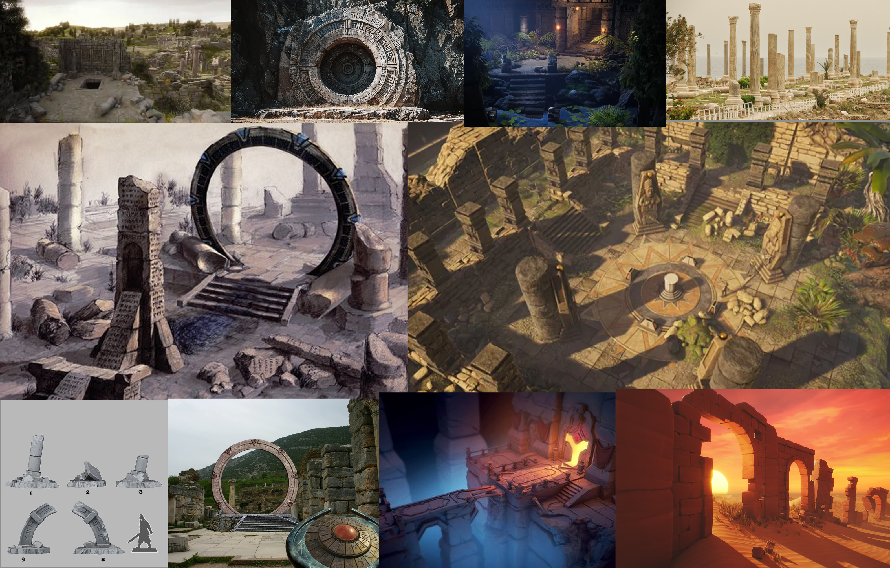
Ruins Moodboard

Slide 6
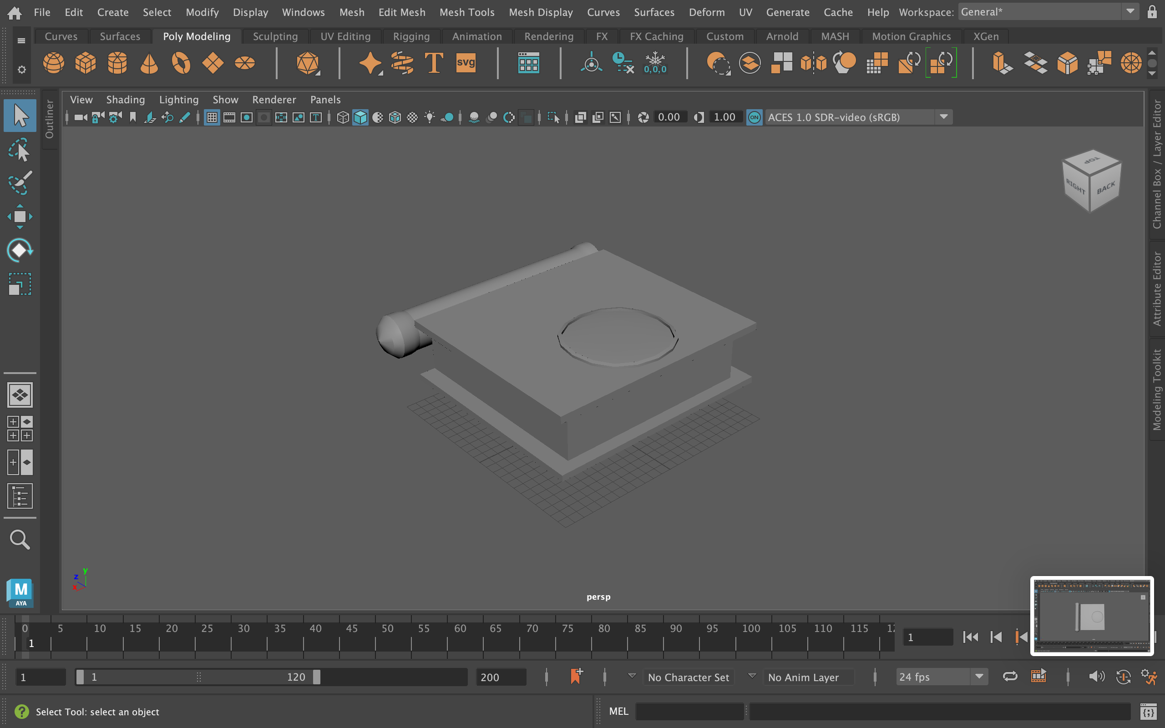
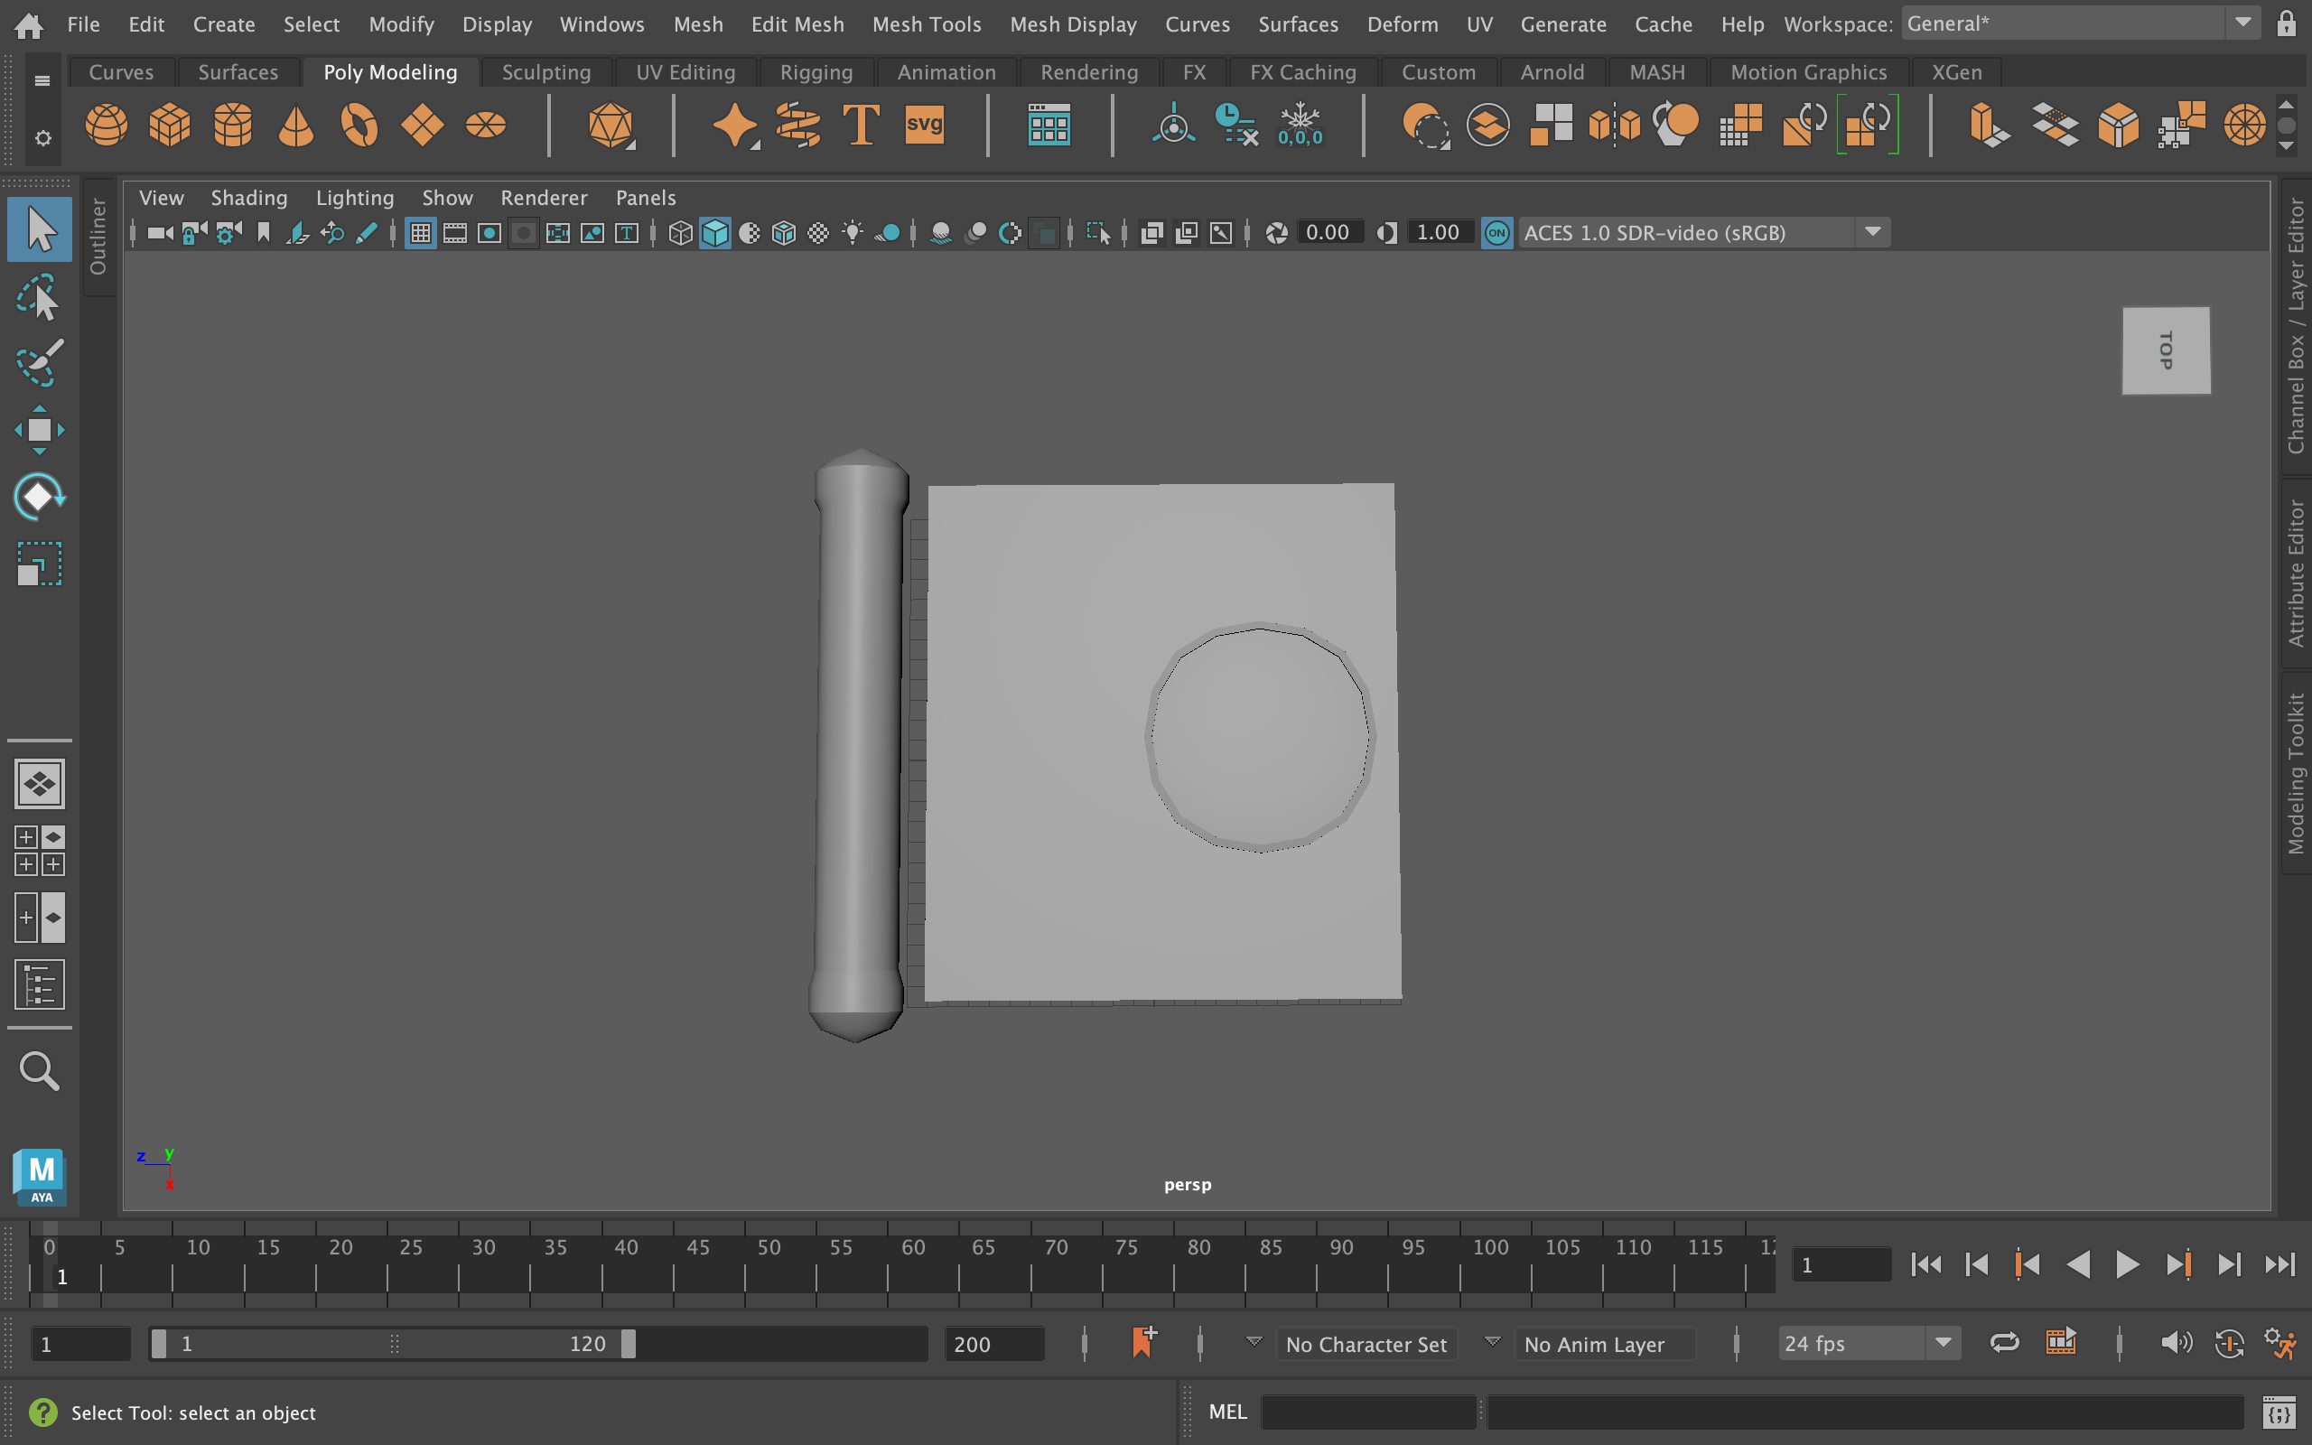
Artifact Models – Book of The Dead

Slide 7
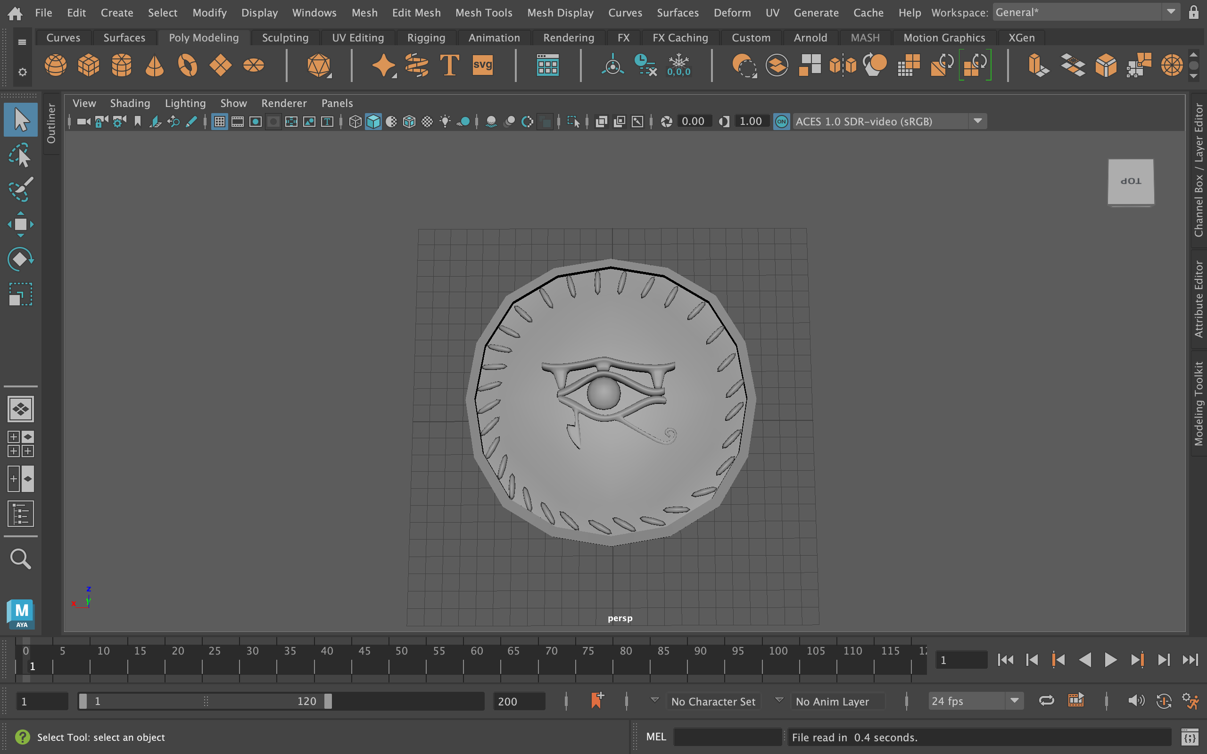
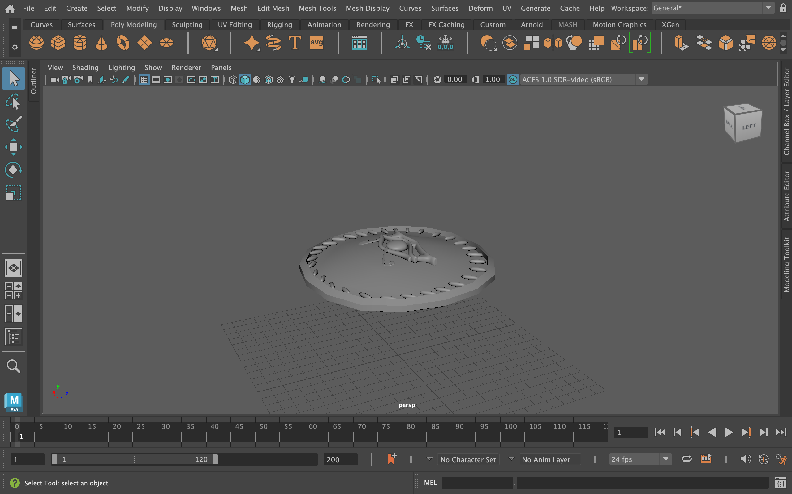
Artifact Models – Eye of Ra

Slide 8
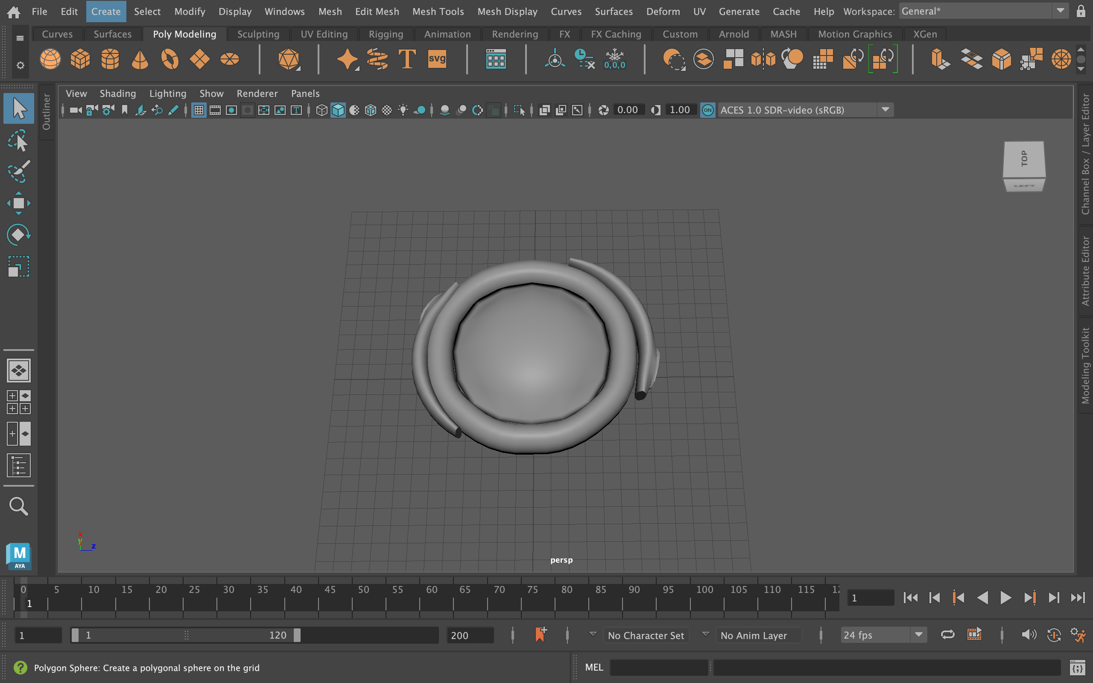
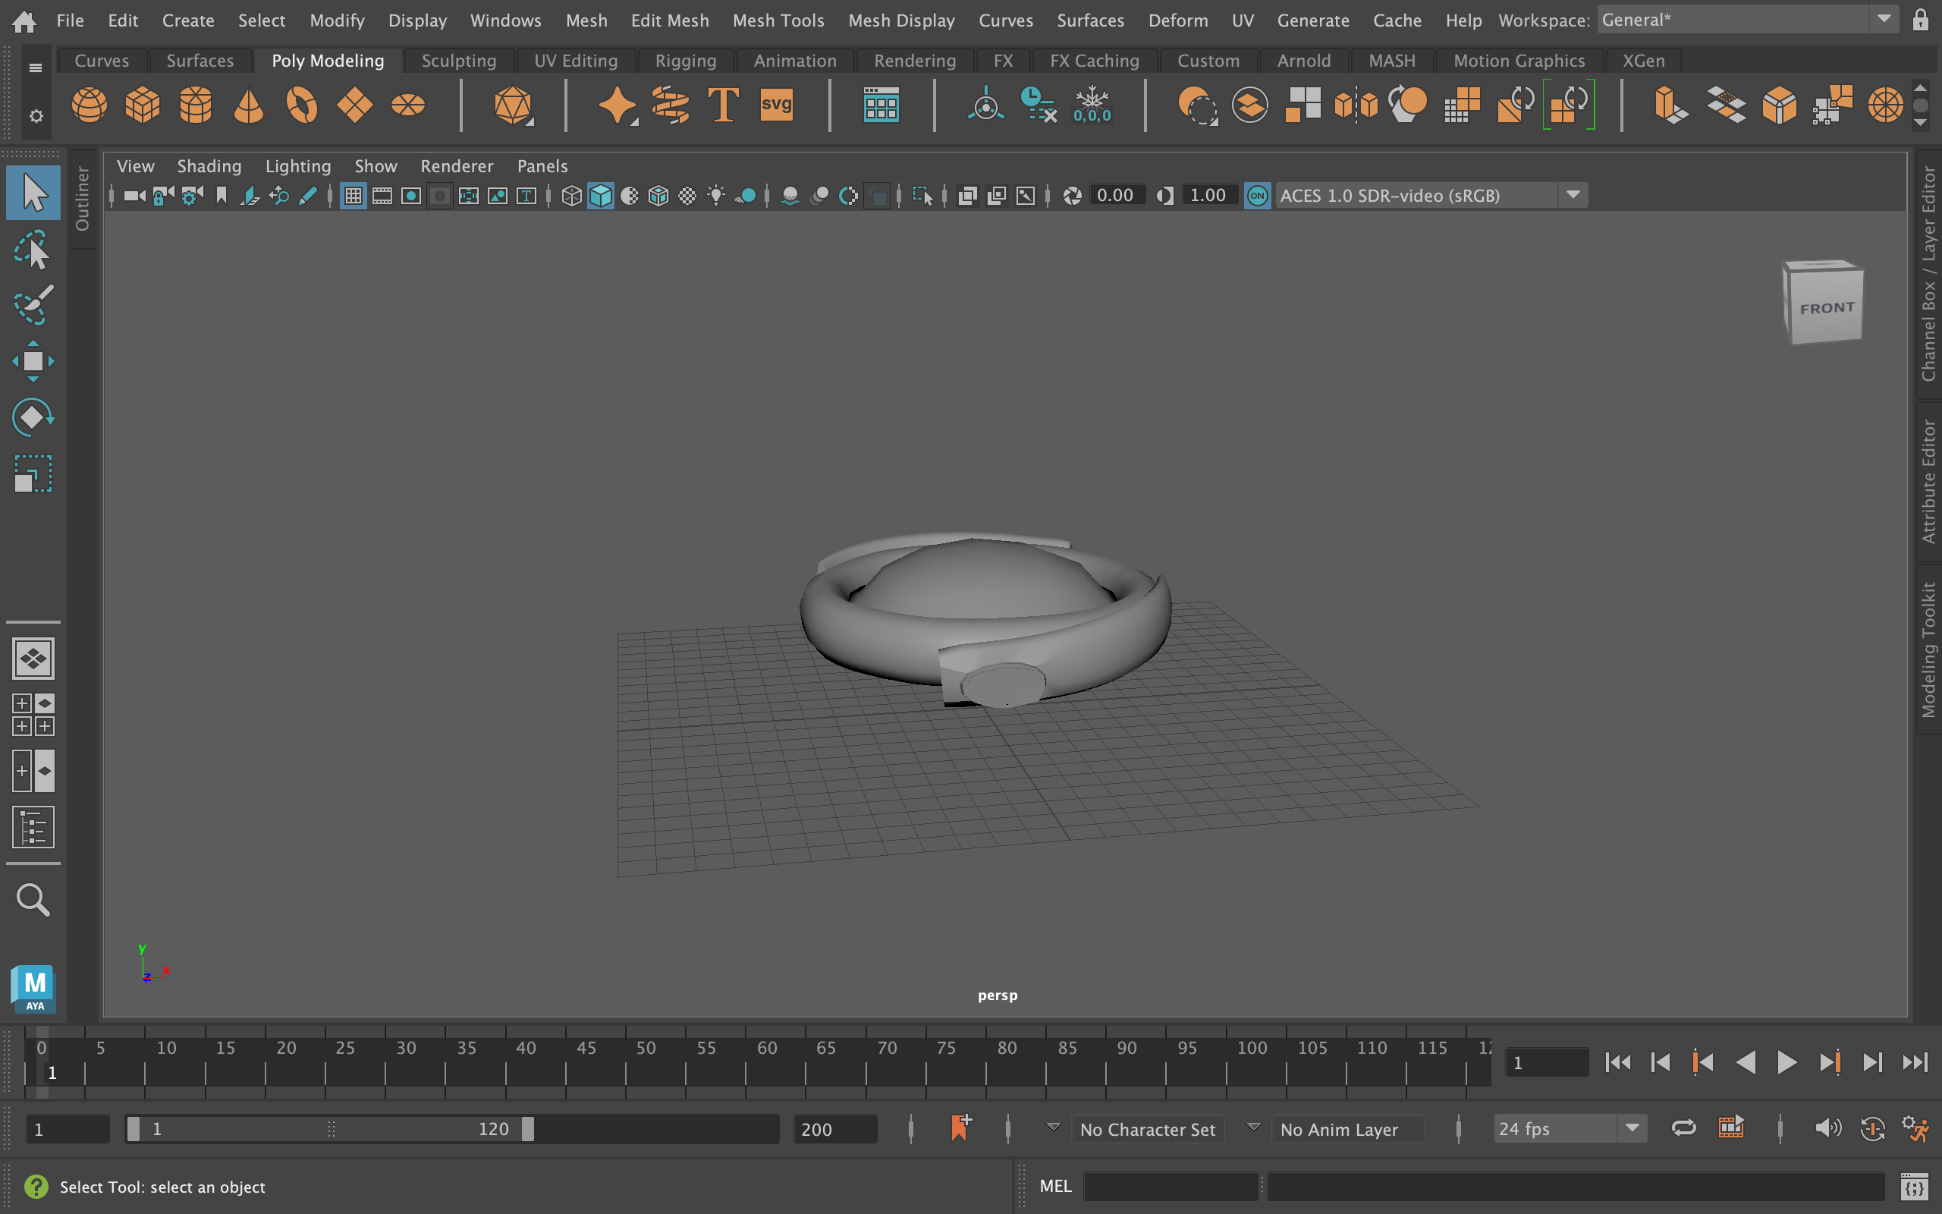
Artifact Models – Goa’uld Ring

Slide 9
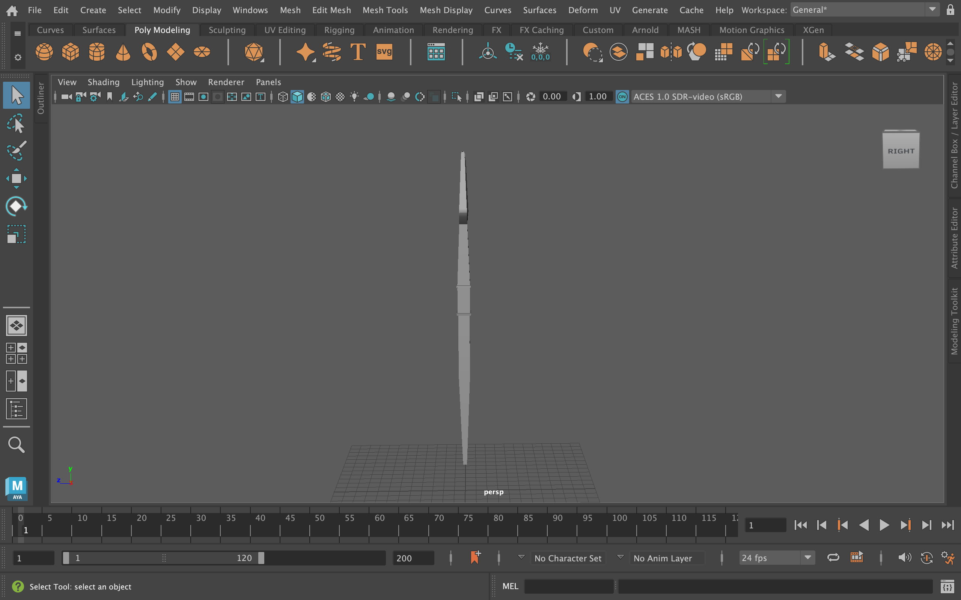
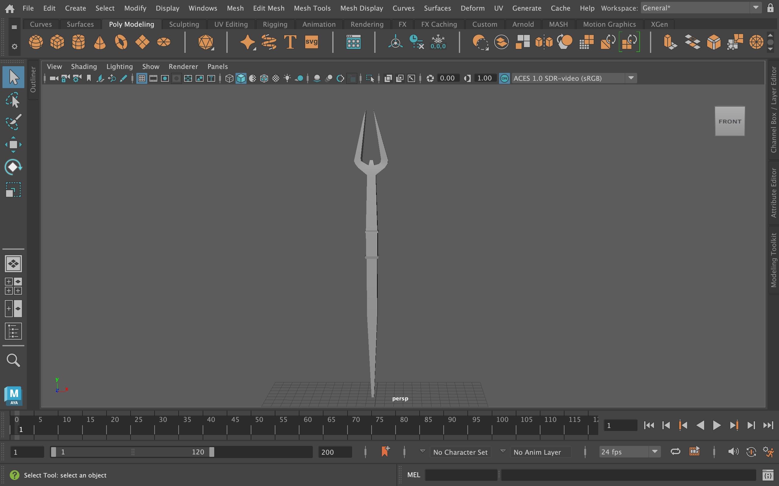
Artifact Models – Ori Staff

Slide 10
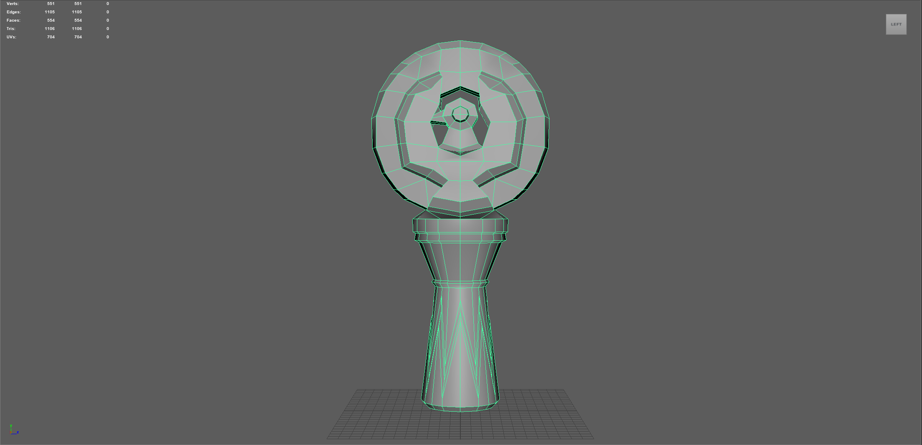
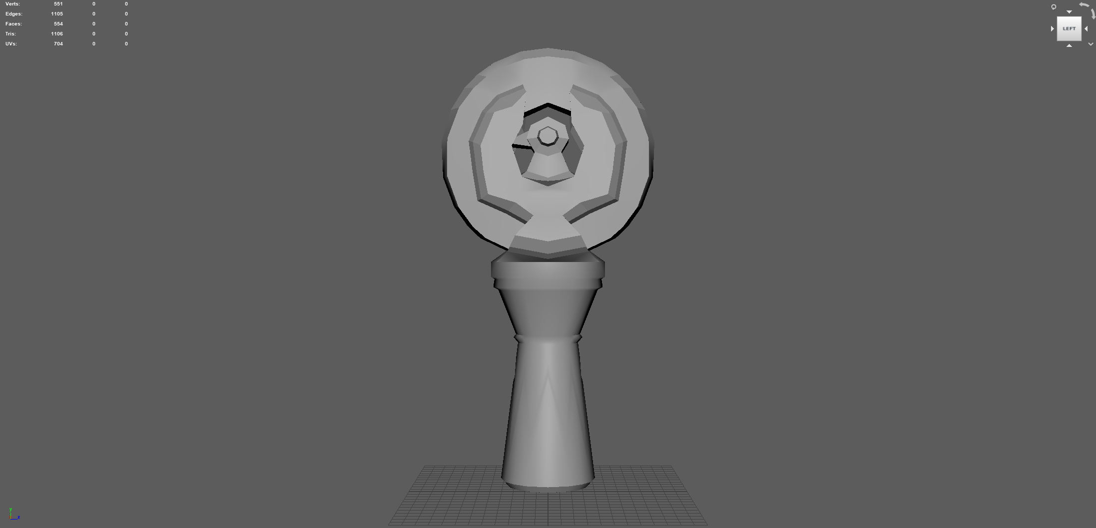
Artifact Models – Staff of Ra

Slide 11
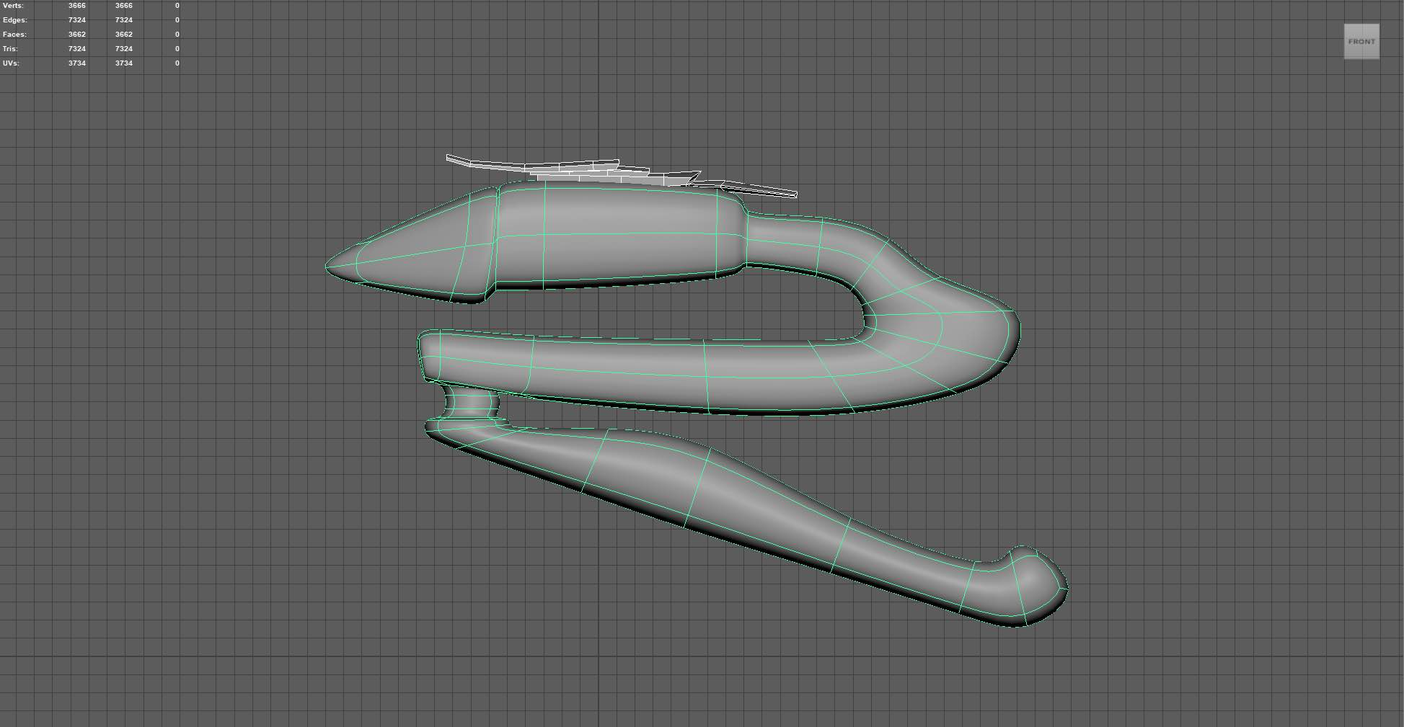
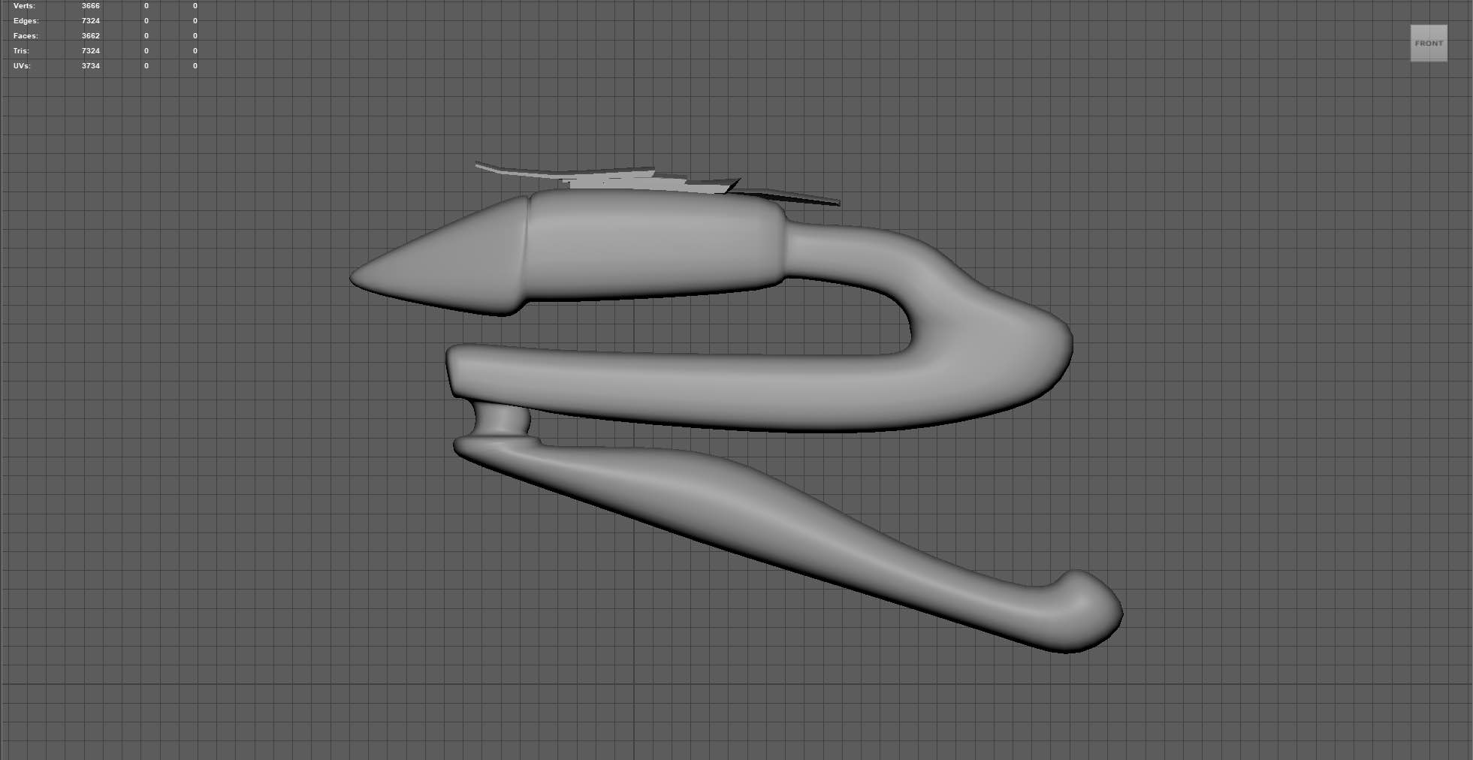
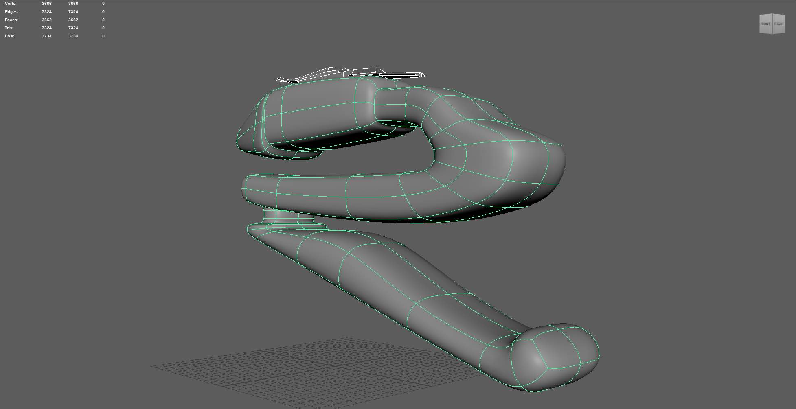
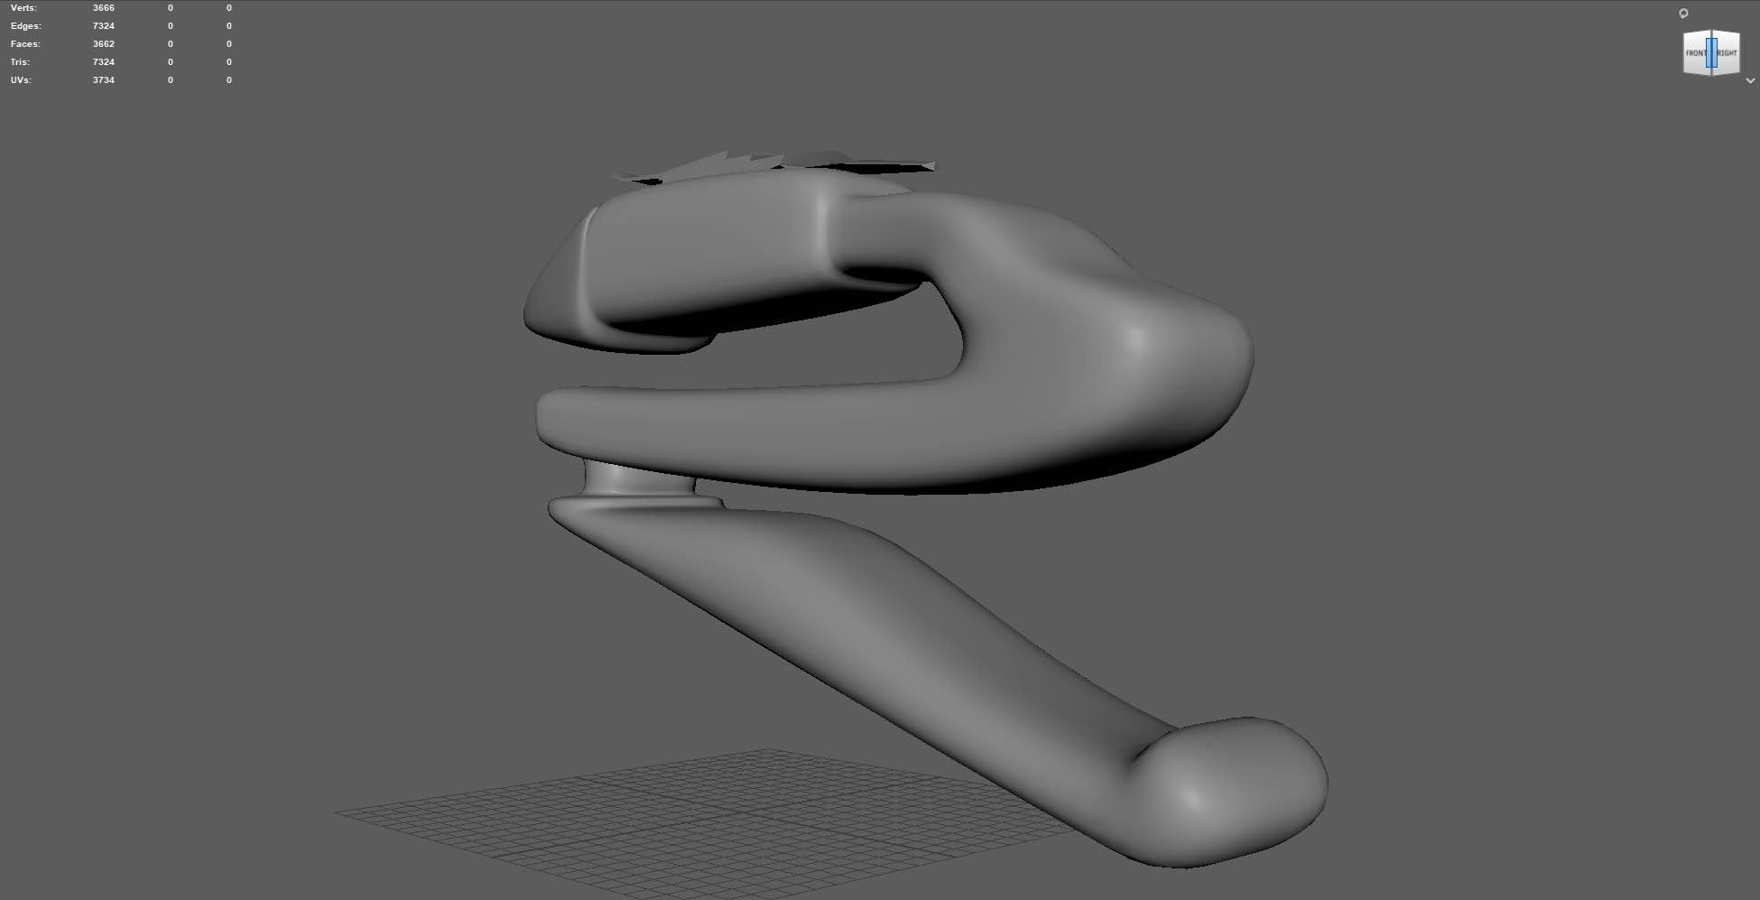
Artifact Models – Zat’nik’tel

Slide 12
Development
Timeline, Terrain Prototype, Player Movement

Slide 13
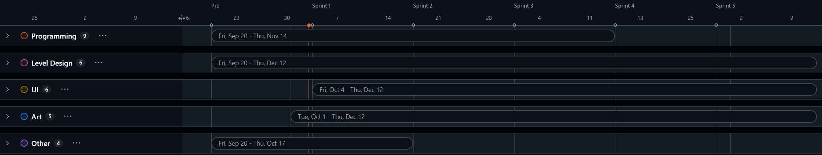
Overall Development Timeline
Fall 24
SEPT
OCT
NOV
DEC

Slide 14
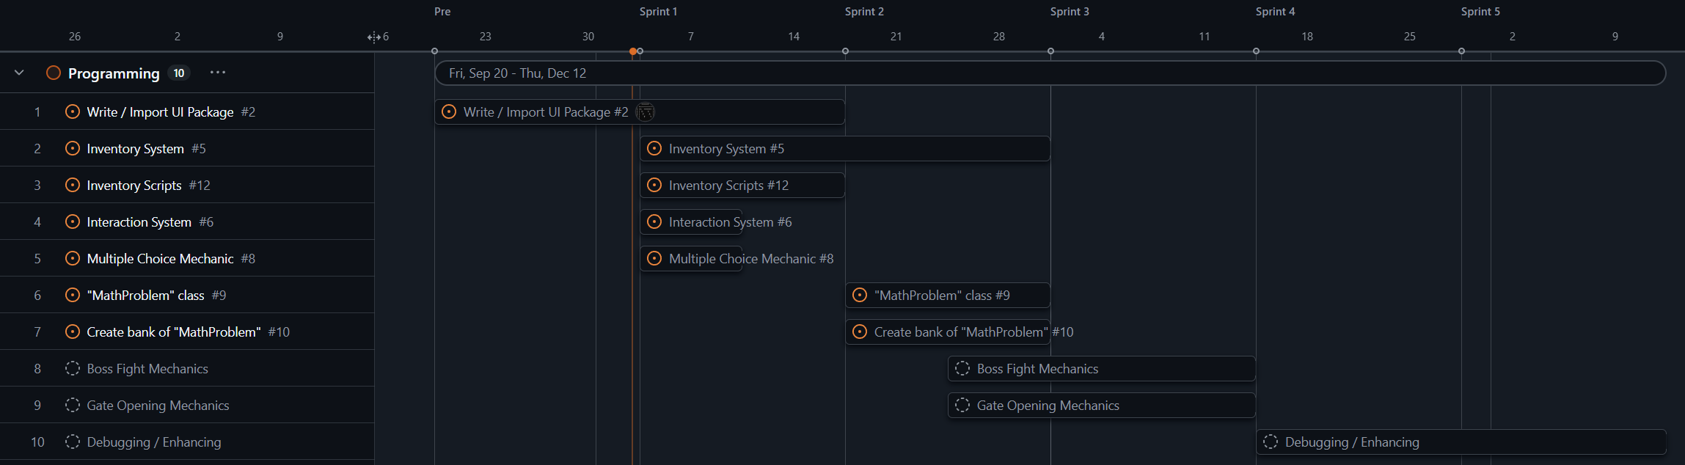
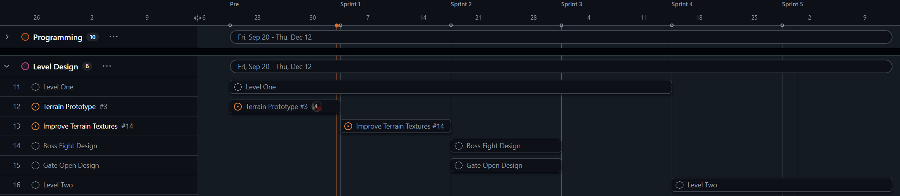
Development Timeline (Detail)
Fall 24
SEPT
OCT
NOV
DEC

Slide 15
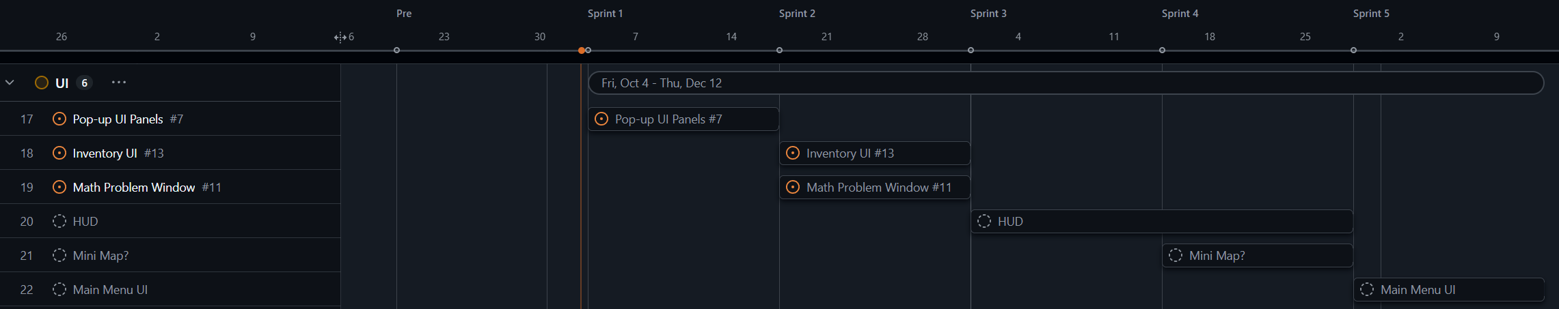
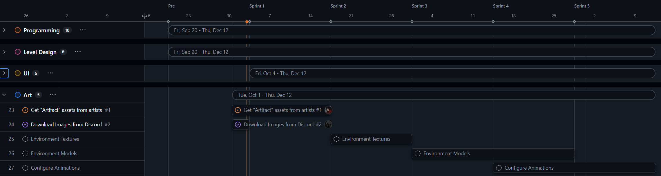
Development Timeline (Detail)
Fall 24
SEPT
OCT
NOV
DEC

Slide 16
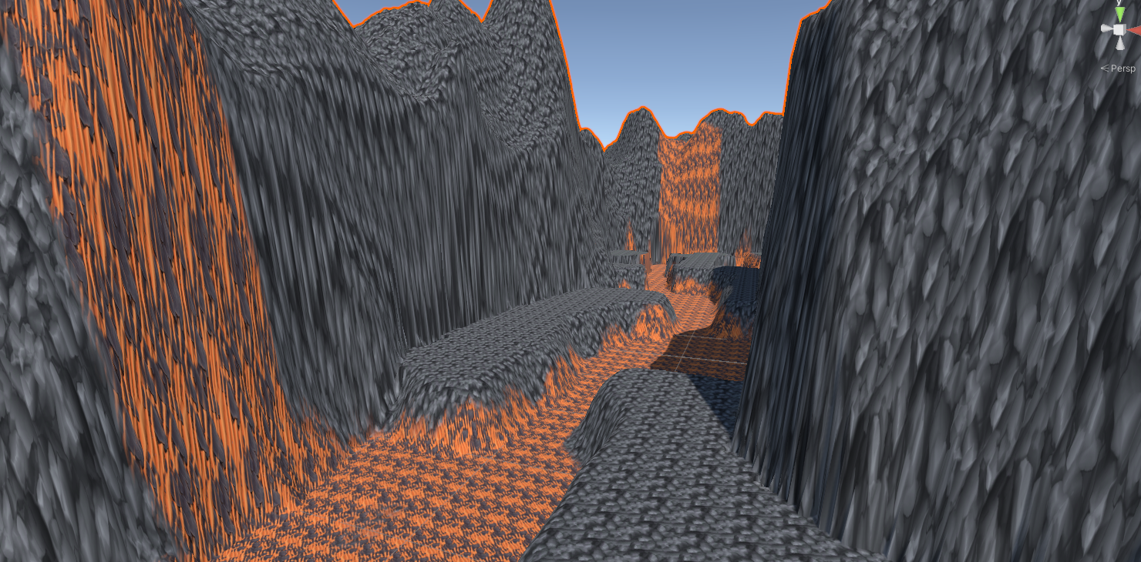
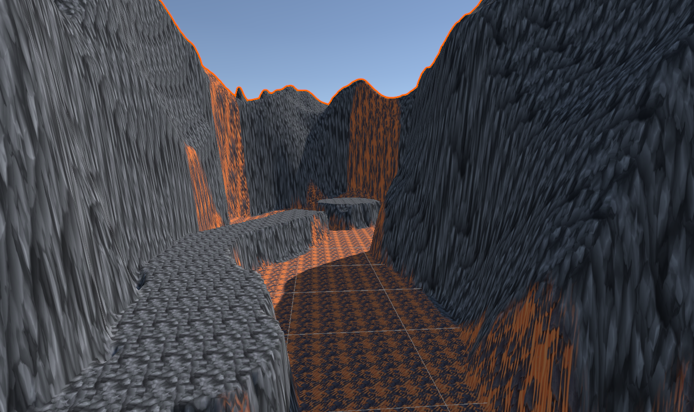
Terrain Prototype

Slide 17
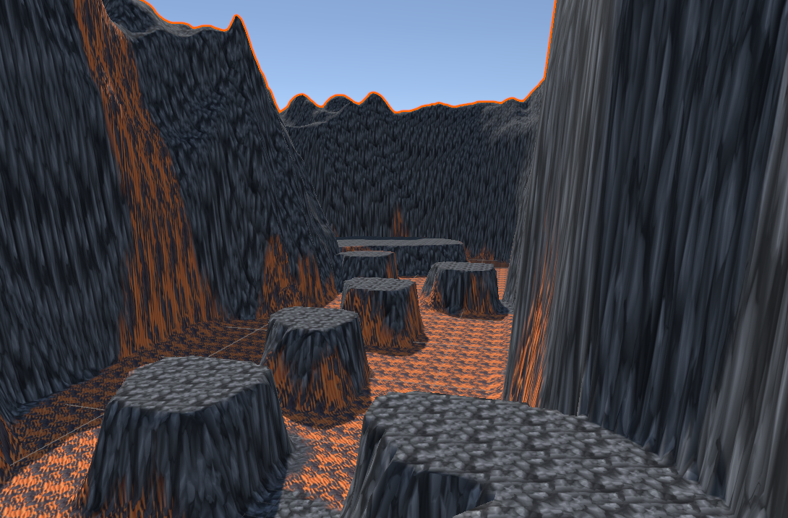
Terrain Prototype
The terrain for the first level was designed to be in a volcanic planet. Along with these different screenshots, below there is a link attached to a video showcasing the entire level.
https://youtu.be/B_-6dUtEgL0

Slide 18
What we need – Problem Pool Document
For each problem:
Factoring Method (GCF, Trinomial, Grouping)
Difficulty Level (Easy, Medium, Hard)
1 Question
Exact wording, if desired
Multiple Choice Answers
1 Correct
3 – 4 Incorrect
Example
1.
Grouping
Easy
“Using grouping, factor the expression completely: [expression here]”
Correct
[Correct answer here]
Incorrect
[Incorrect answer here]
[Incorrect answer here]
[Incorrect answer here]
[Incorrect answer here]

